Slide 1

Intelligent Agent - Chatbot v1.0.0
Team members:
Group 3
Deo Mugabe
Phuong Khanh Nguyen
Geoffrey Duncan Opiyo
Duc Phi Ngo

Slide 2
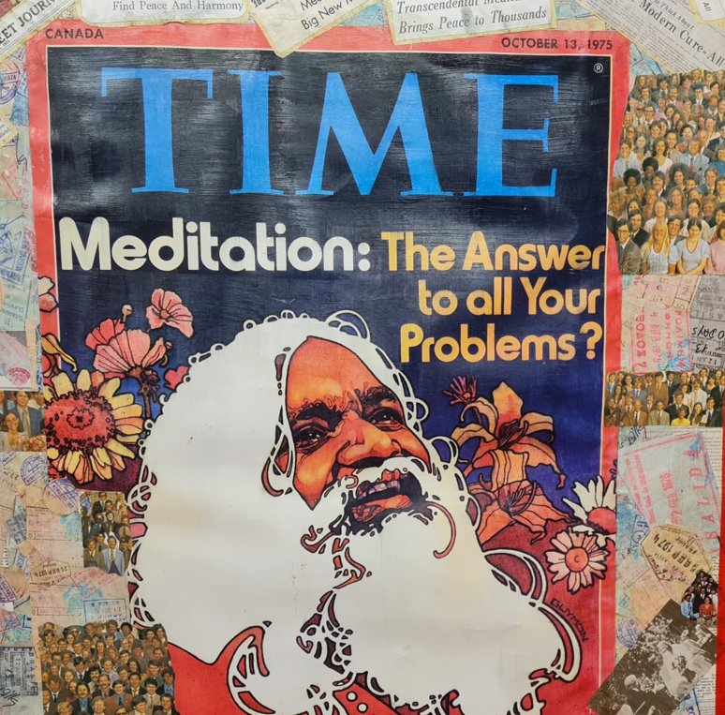
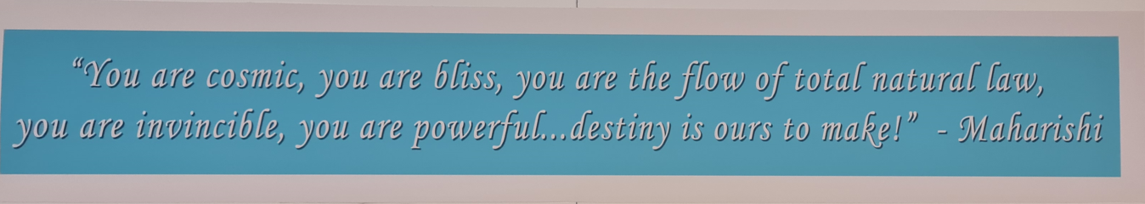
“I hold that life is bliss. In essence, life is not a struggle” – Maharishi Mahesh Yogi

Slide 3
AGENT USE-CASES
Chat bot with Effective Communication
Explore – find product
Place Order
Non-techie user reports
Customer Service
Notes:
Exploration of products: Pacing order by the customers.
Place Order: Tracking order by the customers.
Report Generation: This is a unique use case by using LLM to run DB query on behalf of non-techie users. The user just tell a bot in human language of the task he/she wants completed. The bot then completes it and returns report to users in HTML format (abstracting the technical SQL complexity).
Customer Service:

Slide 4
Content
Problem statement & introduction
Agent and its Architecture
LLM, Vector store & Similarity search
Project Demo & improvement plan
Notes:
Exploration of products: Pacing order by the customers.
Place Order: Tracking order by the customers.
Report Generation: This is a unique use case by using LLM to run DB query on behalf of non-techie users. The user just tell a bot in human language of the task he/she wants completed. The bot then completes it and returns report to users in HTML format (abstracting the technical SQL complexity).
Customer Service:

Slide 5
Problem statement & Introduction
[Chat bot] – Why are they the next big thing?
[Chat bot] – “Conversation as a Platform” - Better customer service and they could even differentiate your business from the crowd.
Examples: Apple – Siri, Microsoft – Cortana, Google – Google Assistant, Amazon – Alexa, and Meta “Facebook” – ITS ALIVE.io, to name but a few.
Notes:
Exploration of products: Pacing order by the customers.
Place Order: Tracking order by the customers.
Report Generation: This is a unique use case by using LLM to run DB query on behalf of non-techie users. The user just tell a bot in human language of the task he/she wants completed. The bot then completes it and returns report to users in HTML format (abstracting the technical SQL complexity).
Customer Service:

Slide 6

Problem statement & Introduction
[Chat bot] – Why are they the next big thing?
In the dynamic landscape of e-commerce, retailers face the challenge of not only attracting customers but also enhancing their shopping experience to foster loyalty and repeat business. Traditional online retail interfaces, while functional, often lack the personalized touch and intelligent interaction that modern consumers crave. Customers frequently encounter issues such as difficulty in finding specific products, lack of personalized recommendations, and inadequate support for queries and concerns. This gap in customer experience can lead to reduced customer satisfaction and ultimately impact the retailer's bottom line.
Notes:
Exploration of products: Pacing order by the customers.
Place Order: Tracking order by the customers.
Report Generation: This is a unique use case by using LLM to run DB query on behalf of non-techie users. The user just tell a bot in human language of the task he/she wants completed. The bot then completes it and returns report to users in HTML format (abstracting the technical SQL complexity).
Customer Service:

Slide 7
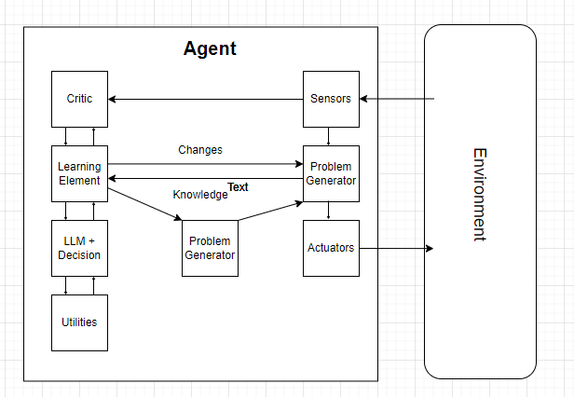
GENERAL ARCHITECTURE

Slide 8
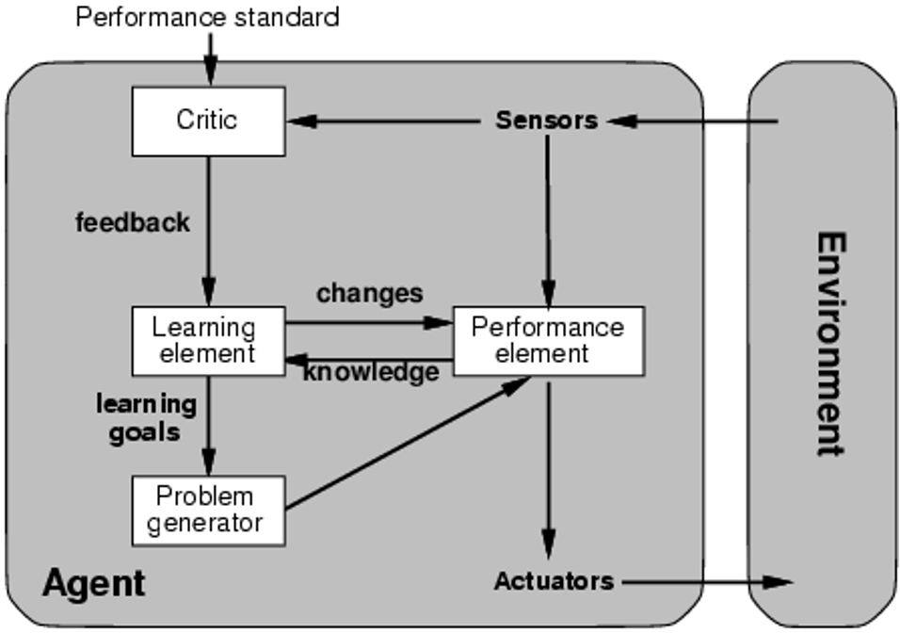
AGENT ARCHITECTURE

Slide 9
AGENT ARCHITECTURE
Learning element: makes improvements.
Performance element: selects external actions based on percept (entire agent in previous cases).
Critic: gives feedback to learning about success (it tells the learning element how well the agent is doing with respect to a fixed performance standard.
Problem generator: suggests actions to find new states.

Slide 10
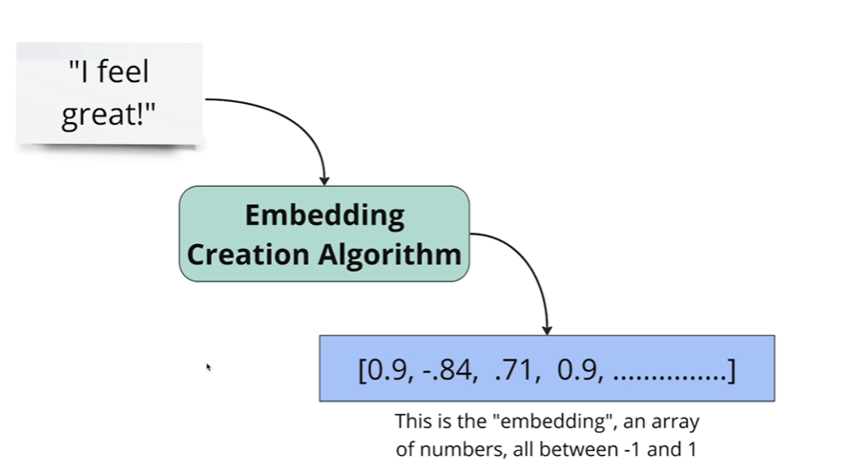
Split the text into separate chunk
Calculate embedding for each chunk
Store embedding in a database specialized for storing embedding
This facilitates fast searching, recommendation and classification
EMBEDDING
Notes:
1. Load Source Data: We loaded KB in JSON format into Vector Store

Slide 11
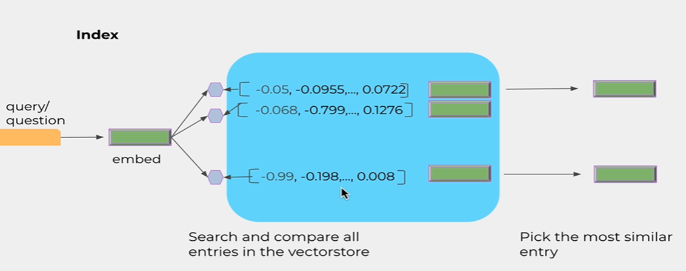
VECTOR SEARCH

Slide 12
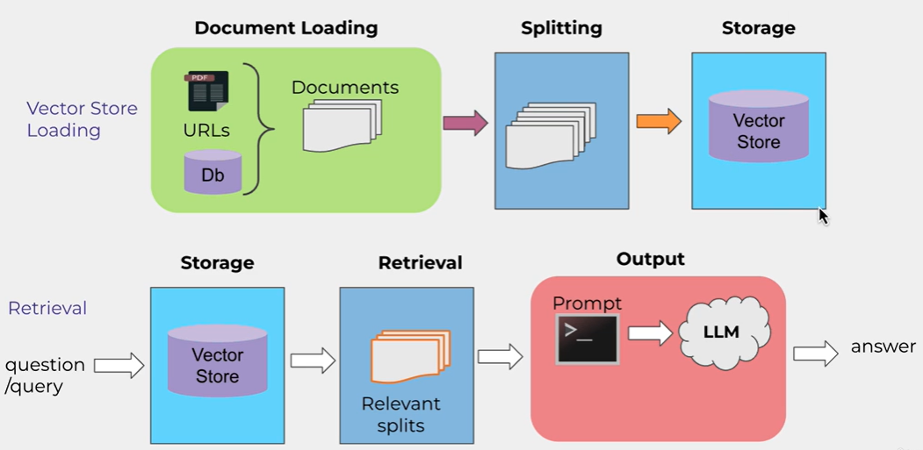
VECTOR STORAGE OF OUR “KB” INTO VECTOR DATABASE FAISS
Notes:
1. Load Source Data: We loaded KB in JSON format into Vector Store

Slide 13
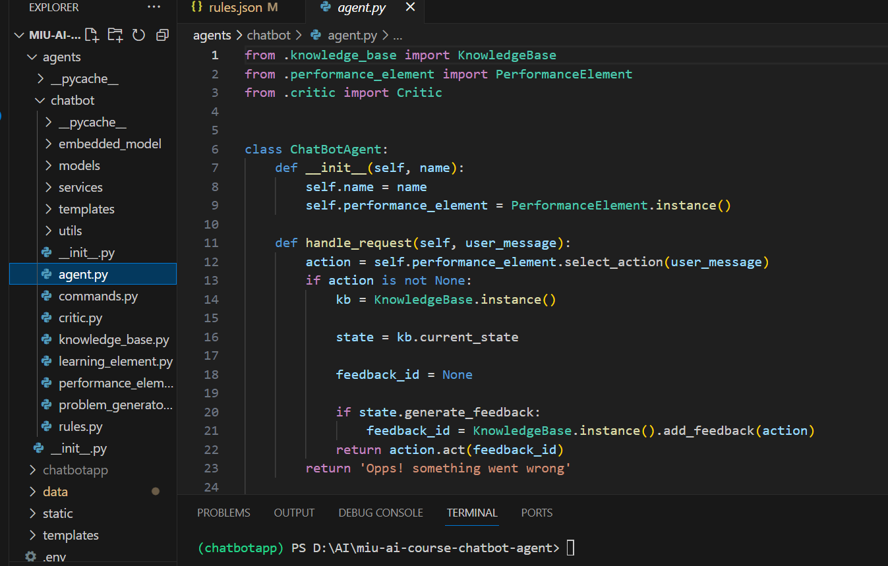
A SNEAK PEEK INTO THE CODE BASE

Slide 14
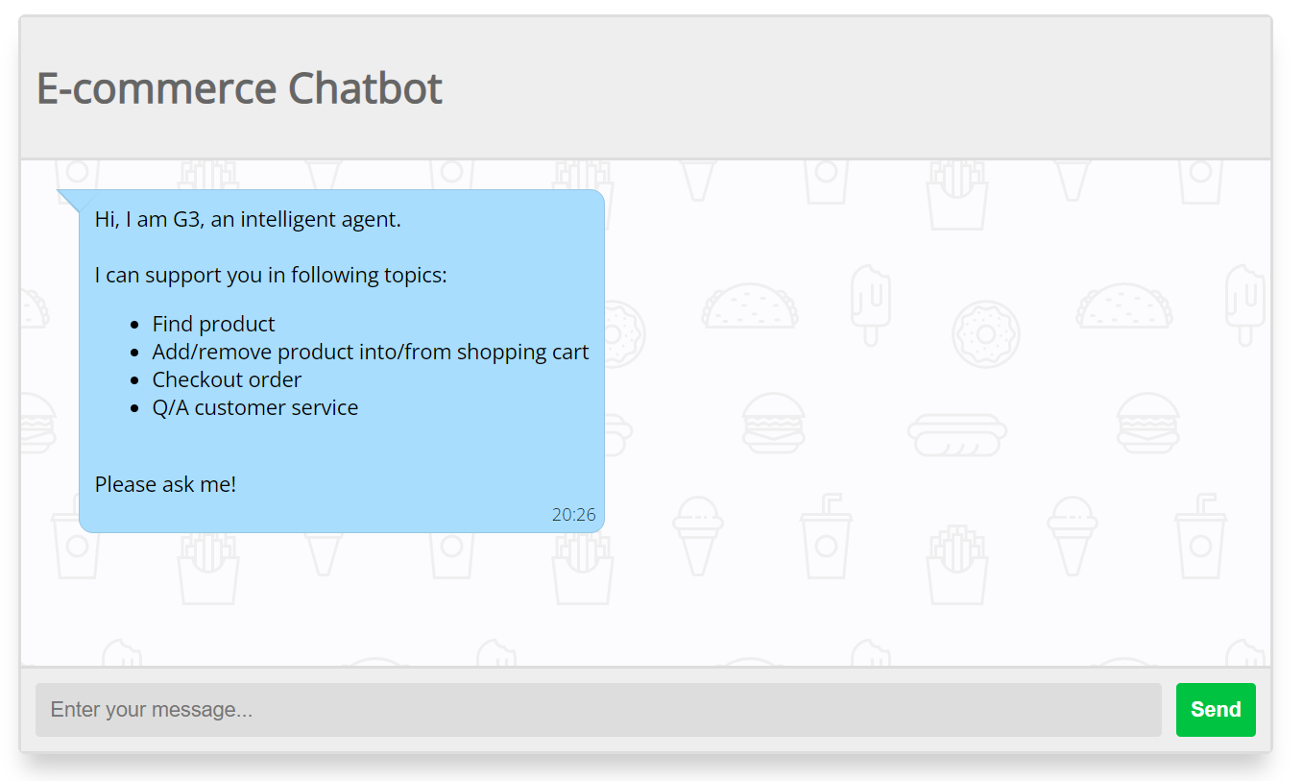
A DEMO

Slide 15
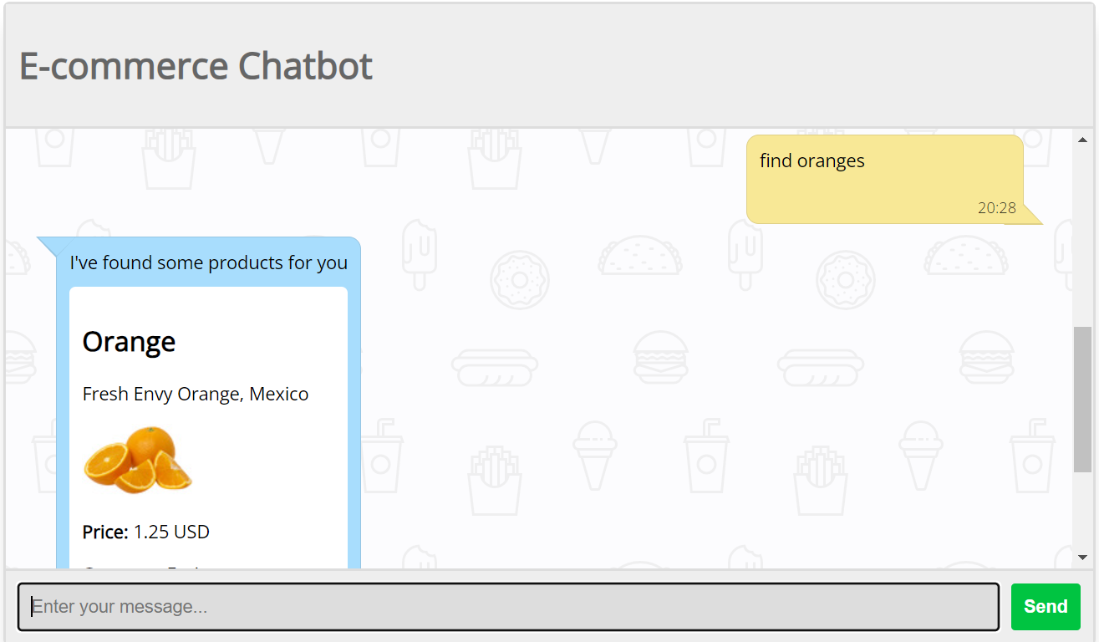
A DEMO

Slide 16
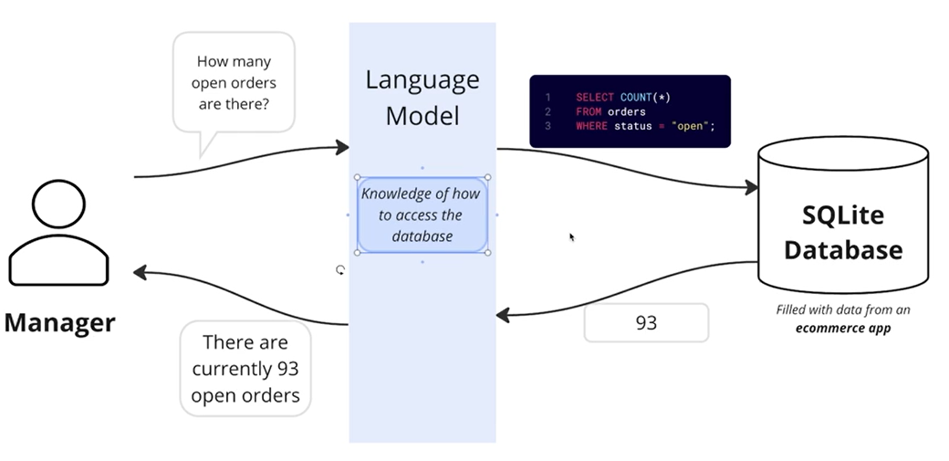
FUTURE WORK: Report Module for an E-commerce Employee who is a Non-Techie

Slide 17
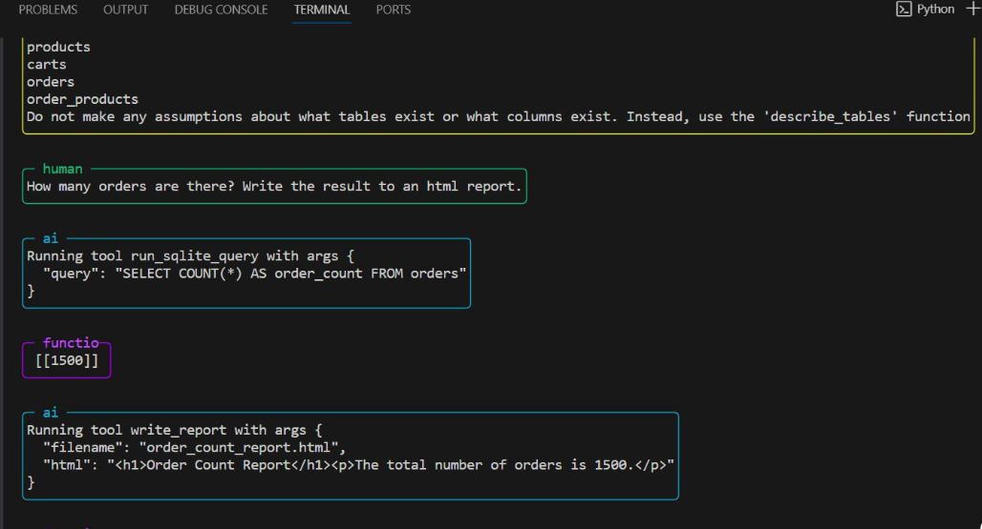
FUTURE WORK: Report Module for an E-commerce Employee who is a Non-Techie

Slide 18

Practice TM
Group 2 – with LOVE
Wisdom
Creativity
Unbounded Awareness

